Slide 1
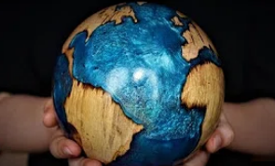
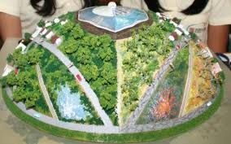
Investigation
Investigated possible ideas that I could use.
The colours represent advantages and disadvantages.
1. Climate emergency t-shirt
Aesthetics: The font styles and the colour contrast can be seen as aesthetic
Consumer: ENTERETERETETERETE
Cost: $20
Environment & Sustainability: Cotton is a renewable resource and doesn’t require chemicals. Also, it is durable. The product is manufactured in Australia but is sold worldwide. Therefore, the transportation process, which uses fossil fuels, increases the carbon footprint and hence the environment costs.
Size: Approximately 60cm in width and 80cm in height
Safety: No real concerns of danger
Function: It has two functions. One as the function of a clothing and the other to spread awareness to anyone who sees the clothing text.
Manufacture: Cotton is loomed and weaved. Then it is cut into the desired shape. Lastly, the text is printed on the shirt.
Materials: Cotton (not timber)
2. Automata
Aesthetics: It is made as an artwork. The wood grains may seem appealing.
Consumer: ENTERETERETETERETE
Cost: ranges from $15(build kits) to $950(high-quality automata)
Environment & Sustainability: The wood can be recycled or recovered as fuel. The wood could also be reused as this product has large areas where
Size: 210 cm x 60 cm x 60 cm (too big)
Safety: It may tip over.
Function: It alerts the audience about the urgency of the current climate emergency situation.
Manufacture: The timber is carved and sculpted.
Materials: Timber

Slide 2
Investigation
Investigated possible ideas that I could use,
The colours represent advantages and disadvantages.
Investigating existing products – Ideas I could use:
3. Water bottles
Aesthetics: The font styles and the colour contrast can be seen as aesthetic
Consumer: ENTERETERETETERETE
Cost: $33
Environment & Sustainability: Cotton is a renewable resource and doesn’t require chemicals. Also, it is durable. The product is manufactured in Australia but is sold worldwide. Therefore, the transportation process, which uses fossil fuels, increases the carbon footprint and hence the environment costs.
Size: Approximately 60cm in width and 80cm in height
Safety: No real concerns of danger
Function: It has two functions. One as the function of a clothing and the other to spread awareness to anyone who sees the clothing text.
Manufacture: Cotton is loomed and weaved. Then it is cut into the desired shape. Lastly, the text is printed on the shirt.
Materials: Cotton (not timber)
2. Wooden Sculpture representing global warming.
Aesthetics: It is made as an artwork. The wood grains may seem appealing.
Consumer: ENTERETERETETERETE
Cost: $8,000 (too expensive)
Environment & Sustainability: The wood can be recycled or recovered as fuel. The wood could also be reused as this product has large areas where
Size: 210 cm x 60 cm x 60 cm (too big)
Safety: It may tip over.
Function: It alerts the audience about the urgency of the current climate emergency situation.
Manufacture: The timber is carved and sculpted.
Materials: Timber

Slide 3
Aesthetics:
Consumer:
Environment & Sustainability:
Size:
Safety:
Function:
Manufacture:
Materials:
Aesthetics: No attributes that suggests the product to be aesthetic
Consumer: These products are limited to one or two people when playing with it. Therefore, it doesn’t satisfy our user needs for a interactive playground equipment
Environment & Sustainability: The metal bits can be reused. The product lasts long(a lifetime). The wood can be recycled or recovered as fuel/
Size: Available in different sizes. Normally a meter wide and a meter high
Safety: Most of the time it would be safe unless kids aren’t looking where they are headed and crashes. Rounded edges to protect children against bumps
Function: They can play tic-tac-toe with it.(have fun with gears or play connect-4)
Manufacture: Reasonably easy. Drill holes on the rods and attach the panel
Materials: The panel is usually made with plastic and the outer rods that fix the panel to the ground is metal or wood.
(example)

Slide 4
Research
The colours represent advantages and disadvantages.
Ideas I could use.
Aesthetics:
Consumer:
Environment & Sustainability:
Size:
Safety:
Function:
Manufacture:
Materials:

Slide 5
Aesthetics:
Consumer:
Environment & Sustainability:
Size:
Safety:
Function:
Manufacture:
Materials:
Aesthetics: No attributes that suggests the product to be aesthetic
Consumer: These products are limited to one or two people when playing with it. Therefore, it doesn’t satisfy our user needs for a interactive playground equipment
Environment & Sustainability: The metal bits can be reused. The product lasts long(a lifetime). The wood can be recycled or recovered as fuel/
Size: Available in different sizes. Normally a meter wide and a meter high
Safety: Most of the time it would be safe unless kids aren’t looking where they are headed and crashes. Rounded edges to protect children against bumps
Function: They can play tic-tac-toe with it.(have fun with gears or play connect-4)
Manufacture: Reasonably easy. Drill holes on the rods and attach the panel
Materials: The panel is usually made with plastic and the outer rods that fix the panel to the ground is metal or wood.
(example)

Slide 8
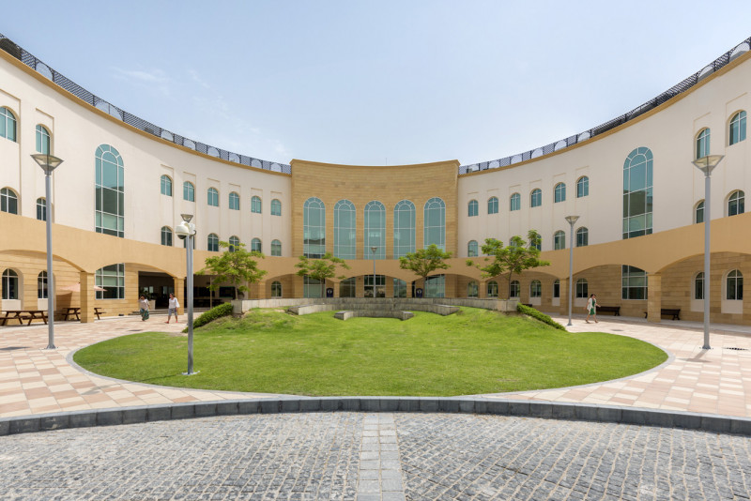
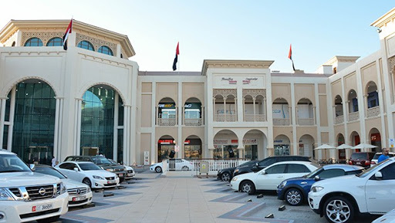
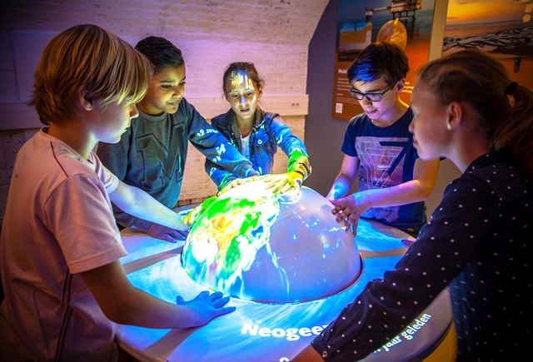
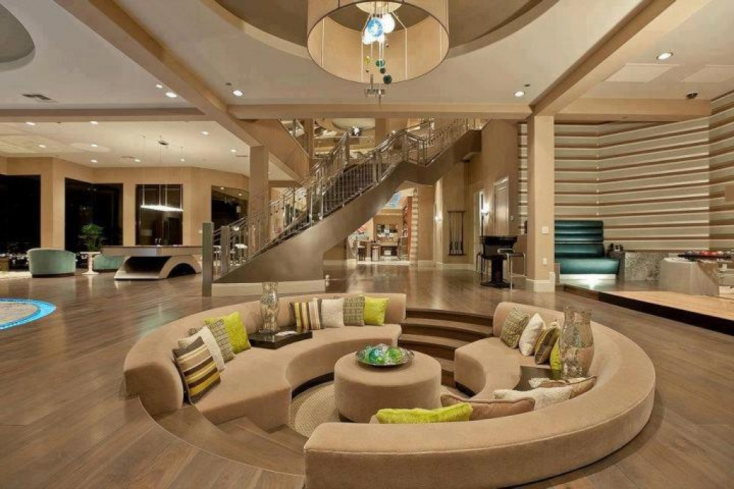
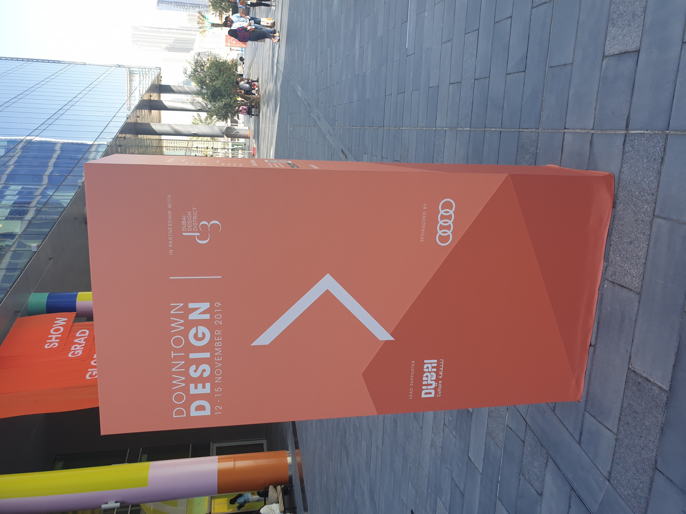
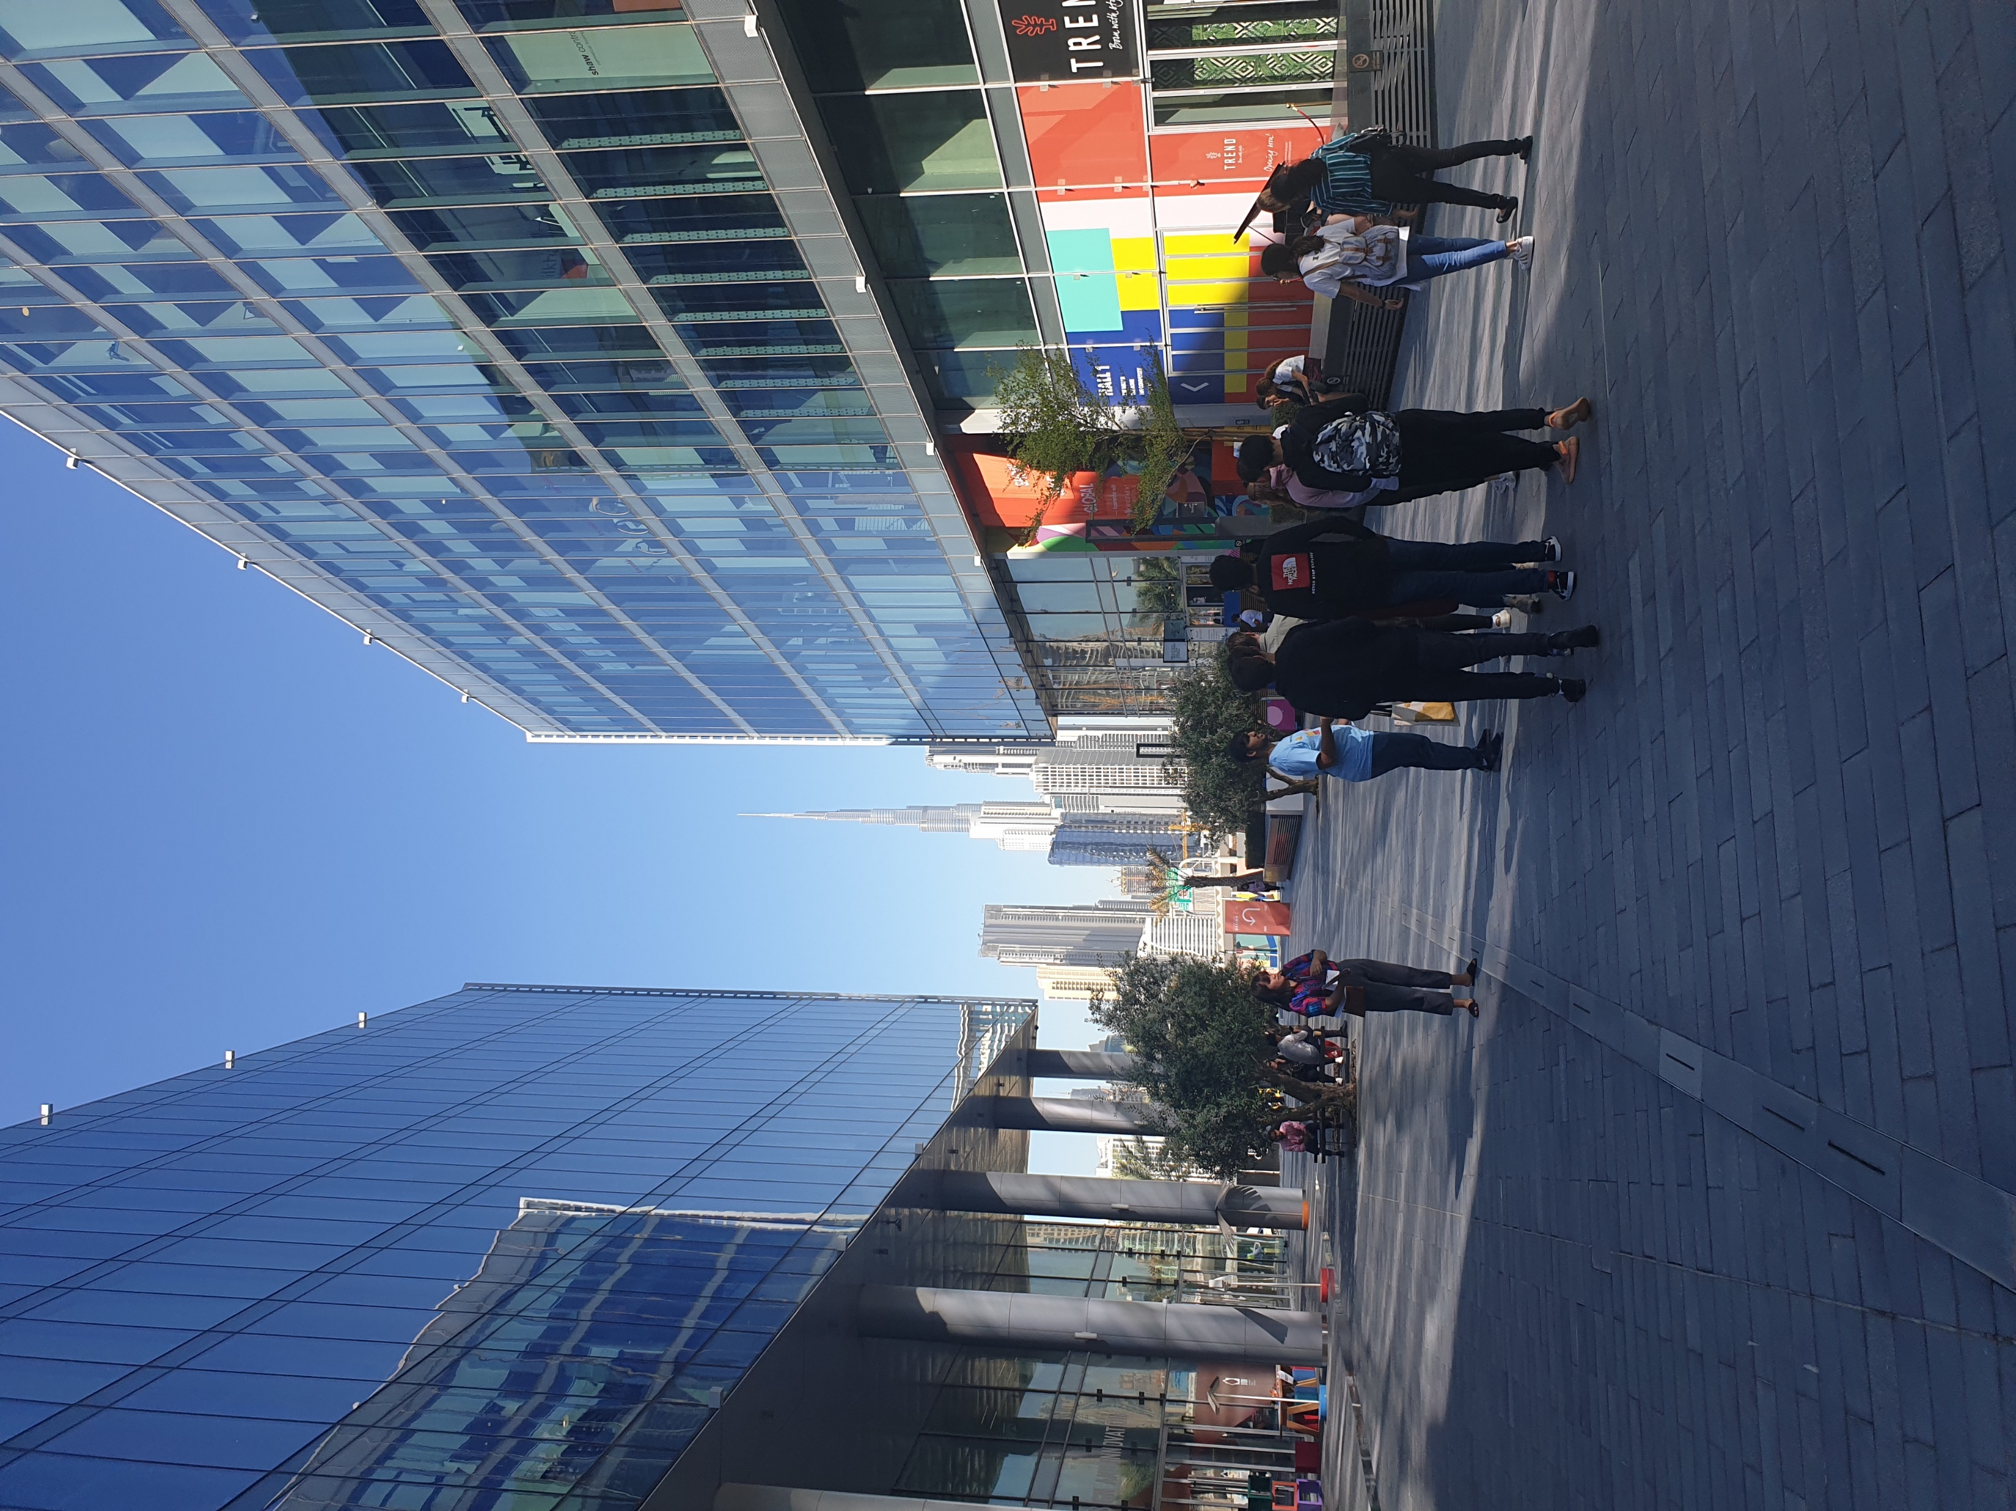
Introduction
A product for acclimate emergency advocate
Toys
Gifts
Models
What
Malls (Al Seef mall)
Schools (Brighton College Abu Dhabi)
Everyday Items
How
How can products be used to increase our awareness of climate emergency?
Adults
Where
Who
Why
When
Both
Students
Museums
In homes
Exhibitions (Dubai design festival)

Slide 9
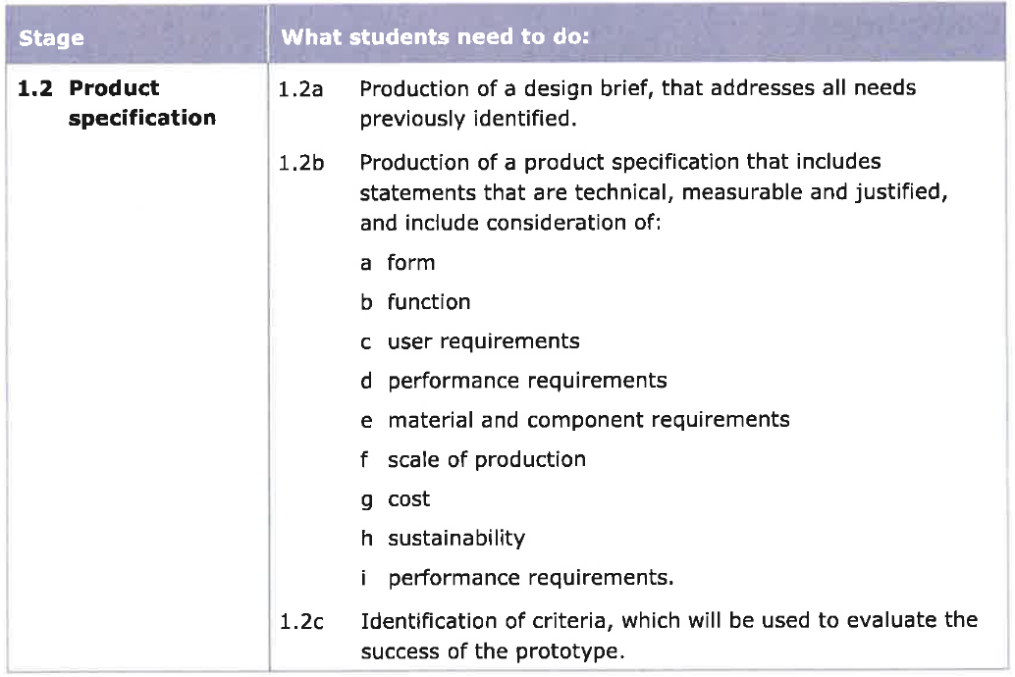

Slide 11
The design/colours should be gender neutral.
The product could/should be linked with mobile devices.
The product should provide in-depth knowledge
The product must draw the user’s attention to be actively engaged.
The product could/should be linked with user interests.
The product should provide methods to contribute in the climate emergency.
The product must convey the urgency of the situation
The product should be durable
The design must not be sensitive in the eyes of the public.
The product must make users aware of climate emergency. -----------→Factors to consider > How I would measure awareness
The product must be under the cost limitations.
The product must use the product to mass method
The product must not be targeted for outdoor use
The product should be intuitive to interact with
The product should be stable during use
The product should be safe to use. -------------Other limitations design
It should be suitable for the demographic based on its anthropometric data
Hallways → The product should be resistant to slight bumps
Hallways → Should have one of those
Hallways → Should withstand leaning force.
Classrooms → Resistant to big bumps
Classrooms → Resistant to drops
Classrooms → Should be smaller that the desk
Classrooms → Should be lightweight
Classrooms → Should withstand weight exerted from above.
E1. Materials must be available in the workshop
E2. Product must be made mostly of wood
C4. The product could use colours associated with global warming.
C3. The design could be representative images of global warming.
If needed, the product should be designed as a knock-down fitting
F1. During production, as little waste possible should be produced. Materials should be accurately calculated.
F2. Materials used in the building should be recyclable, as well as the packaging
F3. Packaging should not use polystyrene
The product should be batch produced.

Slide 12
Outdoors:
From the product investigation, there were two products that were made for outdoor use. Both cases showed that for a product to be placed outdoors and catch the attention of people walking nearby, it had to big in size. The product should also be waterproof to withstand weather conditions. Since there is a lot of sand in the wind, the product should be easy to clean in case it gets dirty. The product should be stable and not tip over.

Slide 13
Investigation
I have identified the a design problem and a need for a product that could solve the problem.
8. Have they put anything into action?
<Source I>
Since source A did not contain survey results from the age group of 12 year olds, I have done a survey to compare the awareness between the first five questions asked. I considered the last two questions not useful for comparison as they did not have a big difference between each year group.
<Source J>
According to source B, half of the responses say they have heard of the term “climate emergency”. However, it is important to note that the other half is unsure or has not heard of the climate emergency.
Source C shows that the most common way of acknowledging climate emergency was via the Internet.
As shown in source D, 1 and 4 scored the highest. Regarding that half is unsure or has not heard of the climate emergency, the “1” was an expected result. However, the “4” indicates that even those who knew about climate emergency did not know fully. Therefore, the product should include depth in knowledge.
Source B and E suggests that even though people have heard of the term climate emergency, they do not look it up themselves. Therefore, it is crucial to have a product that draws the users attention to be actively engaged.
Source F shows that for about 54% think climate emergency is a serious issue. On the other hand, 46%, which is a lot, do not think so. This means, the product should be able to convey the urgency of the situation.
Source H provides a guideline on how I could get my end user’s attention. As shown, games, school subjects, art, and physical activities are some of their common interests. Other interests include, cooking, reading and listening to music.
According to source G and I, it is safe to say that the majority of 12 year-olds have interests in the environment and take action. Some of their eco-friendly actions besides reduce, reuse, and recycle include turning the light off during the day and using sunlight through the window and using a search engine called “Ecosia” that helps plant trees. These sources mean that they have high potential for putting what they learned into practice. Which means it is crucial to inform them about how they could contribute in the climate emergency situation.
Some ways they can contribute based on my secondary research are:
Traveling responsibly
Eating sustainably
Shopping differently
Saving energy in homes
Supporting organizations dedicated to climate emergency
Minimizing waste
Recycling
What it mean by traveling responsibly is for example, to travel short distances by walking or riding a bike instead of car. Also, what it means by eating sustainably is to eat locally and seasonally while reducing meat consumption. Shopping differently refers to shopping products that are sustainable. (FSC etc)

Slide 14
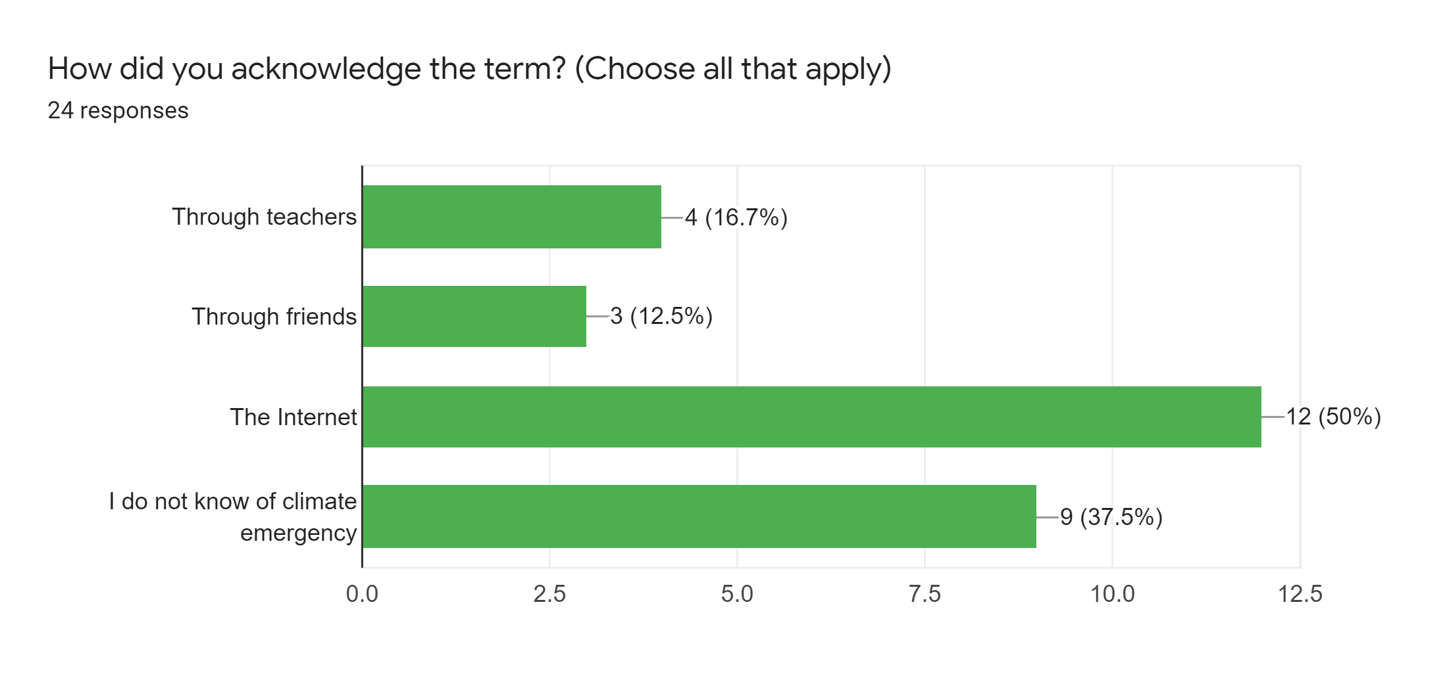
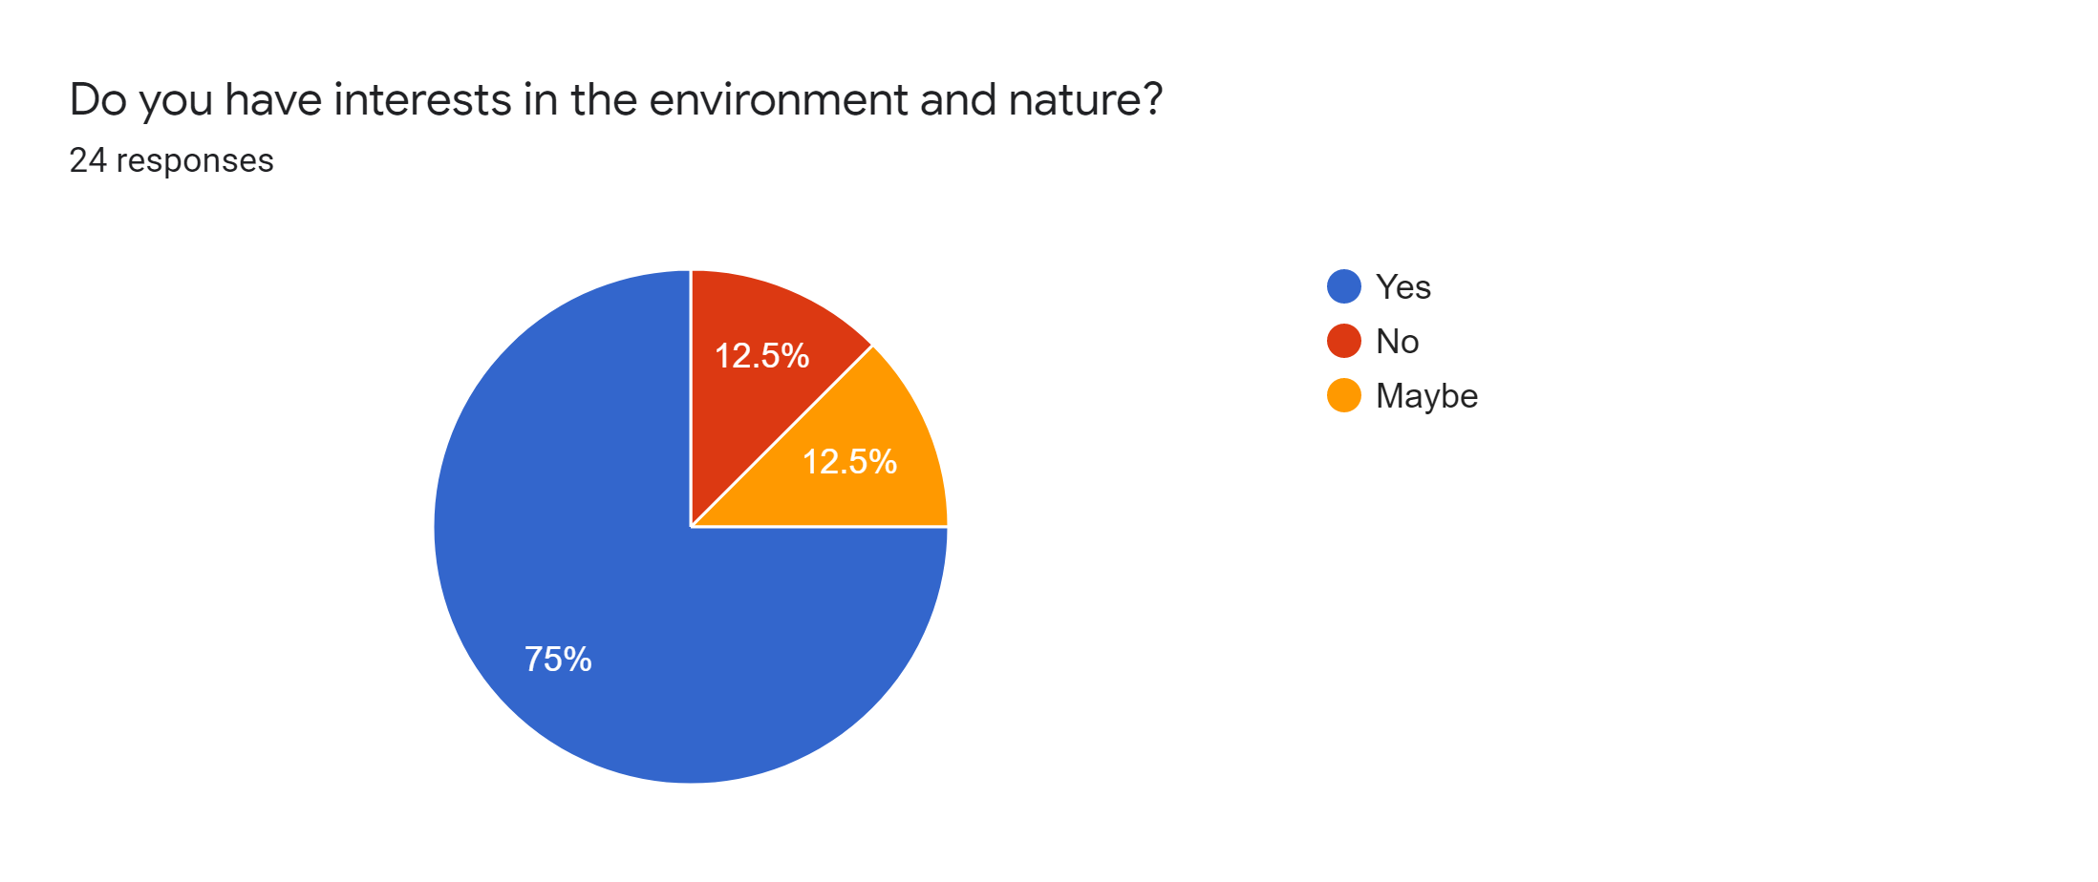
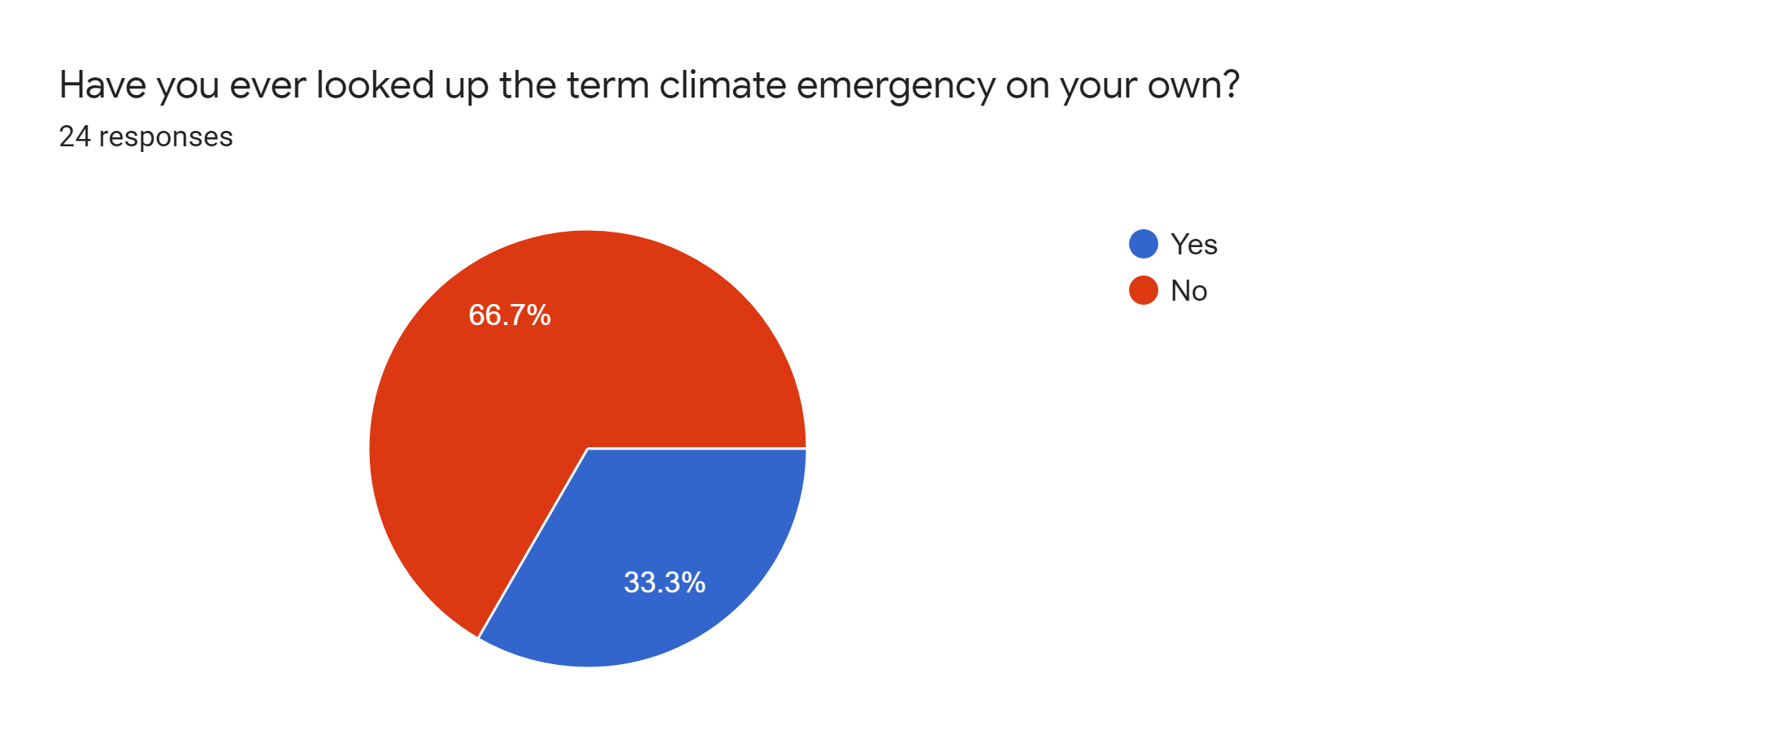
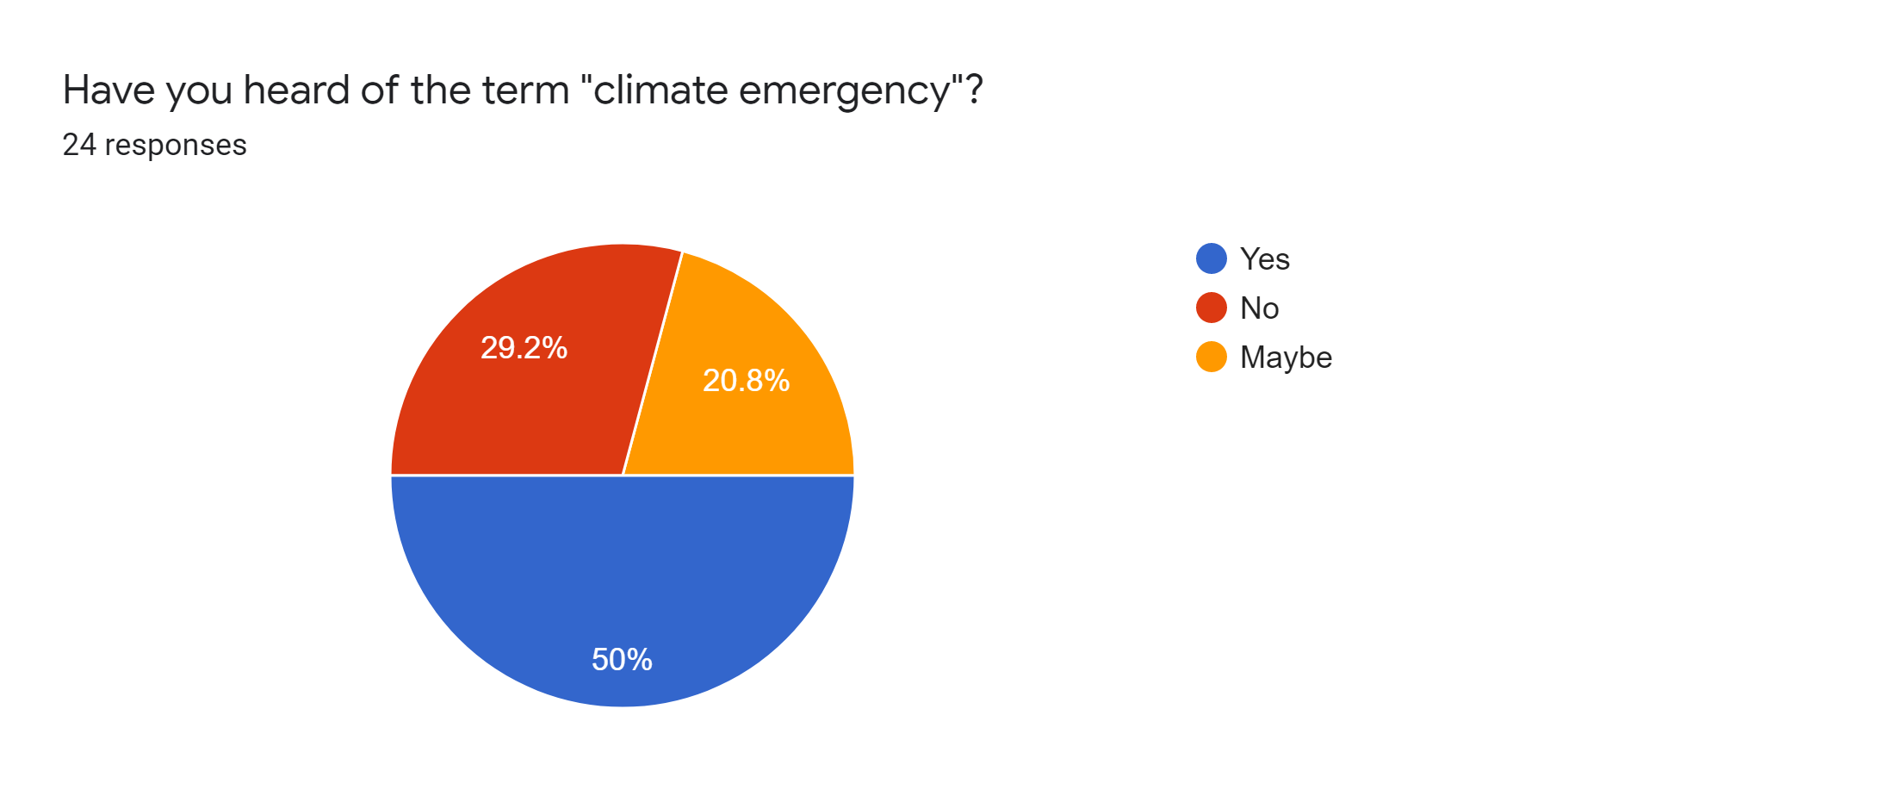
Investigation
The results of the online survey will be displayed.
What I should get from this investigation:
The problem with the current situation
The context of the situation
User behaviours that I should consider
What the product should include
With this in thought I have interpreted the results from an online survey using Google Forms.
Survey Results:
Some questions were asked to scale between 1 to 10. For better data reading I have converted them into a ‘1 to 5 scale’ by merging the adjacent values together. Short-answer questions were grouped together in terms of similar answers. Minor activities were classified as “others”.
1. How many students have heard of climate emergency?
<Source B>
2. How did they hear about climate emergency?
<Source C>
3. What is their depth of knowledge about climate emergency?
<Source D>
4. Has anyone every looked up climate emergency on their own?
<Source E>
5. How serious do they think about climate emergency?
<Source F>
6. Do they have any interest in environment and nature?
<Source G>
7. What are their current interests?
<Source H>
Notes:
Make sure <Source B> doesn’t get cut off when printing

Slide 15
Investigation
The results of the online survey will be displayed.
Conclusions that should be drawn:
Which method to use
Before I dived in, I divided the possible methods of increasing awareness.
Self → Mass
Product → Mass
Products → Individual
What I mean by each terms is that the first one is an individual that chose to buy a product, such as a climate emergency t-shirt, to increase awareness.. The second term refers to a single product that many people can see and interact with. The last term means the same product given out to each individual, cheap pens with intended text printed for instance.
With this in thought I have interpreted the results from an online survey using Google Forms.
Survey Results:
Some questions were asked to scale between 1 to 10. For better data reading I have converted them into a 1 to 5 scale by merging the adjacent values together. Short-answer questions were grouped together in terms of similar answers. Minor activities were classified as “others”. Some questions were asked in order to investigate user behaviours.
1. How many students have heard of climate emergency?
<Source B>
2. How did they hear about climate emergency?
<Source C>
3. What is their depth of knowledge about climate emergency?
<Source D>
4. Has anyone every looked up climate emergency on their own?
<Source E>
5. How serious do they think about climate emergency?
<Source F>
6. Do they have any interest in environment and nature?
<Source G>
7. What are their current interests?
<Source H>
Notes:
Make sure <Source B> doesn’t get cut off when printing

Slide 16
ALL DATA REFERENCES
.
.
.
In general or to do with climate change? (on youtube) I like to see how some companies are trying to minimise waste, how some places are trying to be/are carbon negative/neutral, I'm interested in how nature combats this; there's a type of worm that lives in garbage dumps and can digest plastic, there's also an enzyme that scientists are developing to become stronger that can also eat plastic. In general I like science, technology art and games.
Geography and Languages
.
Games
I’m not sure…
Cooking
try and reduce climate change
.
Video games, cycling, swimming, video production
art
In sports/electronics
Staying safe at home
I enjoy drawing , games , studies.
reading, art and music
.
Yes by using reusable bags
Using metal straws instead of plastic
I only turn on my lights at night as I have a big window that gives me a lot of light, I try to get my parents to go shopping with the plastic bags that we own, I use ecosia as my search engine, I try my best not to waste any paper water and water bottles, I do pretty much everything on my computer to minimise paper usage, sometimes I collect my waste and try to re use it weather its using it for a project or making something out of it.
use no plastic in our household
I have stopped using plastic straws and cups. I also try to pick up trash if i see it
use water bottles
I cut down on plastic…
Reducing my use of plastic and using metal straws instead of plastic straws.
I try not to use plastic such as plastic bottles and try to recycle as much as possible
I have stopped using plastic straws and cups. I also try to pick up trash if i see it
Use reusable water bottles
none
vegetarian and buy mostly ethical bathroom products, like shampoo
I recycled plastic water bottles
I used refillable water bottles.
Me and my family don’t use the plastic bags when grocery shopping, we bring our own, make sure we have a recycling bin and use it properly, have a water dispenser so we don’t buy a lot of water bottles
.
Buy reusable bags and straws
Reduced the amount of plastic i used, used reusable bags when shopping, etc.

Slide 17
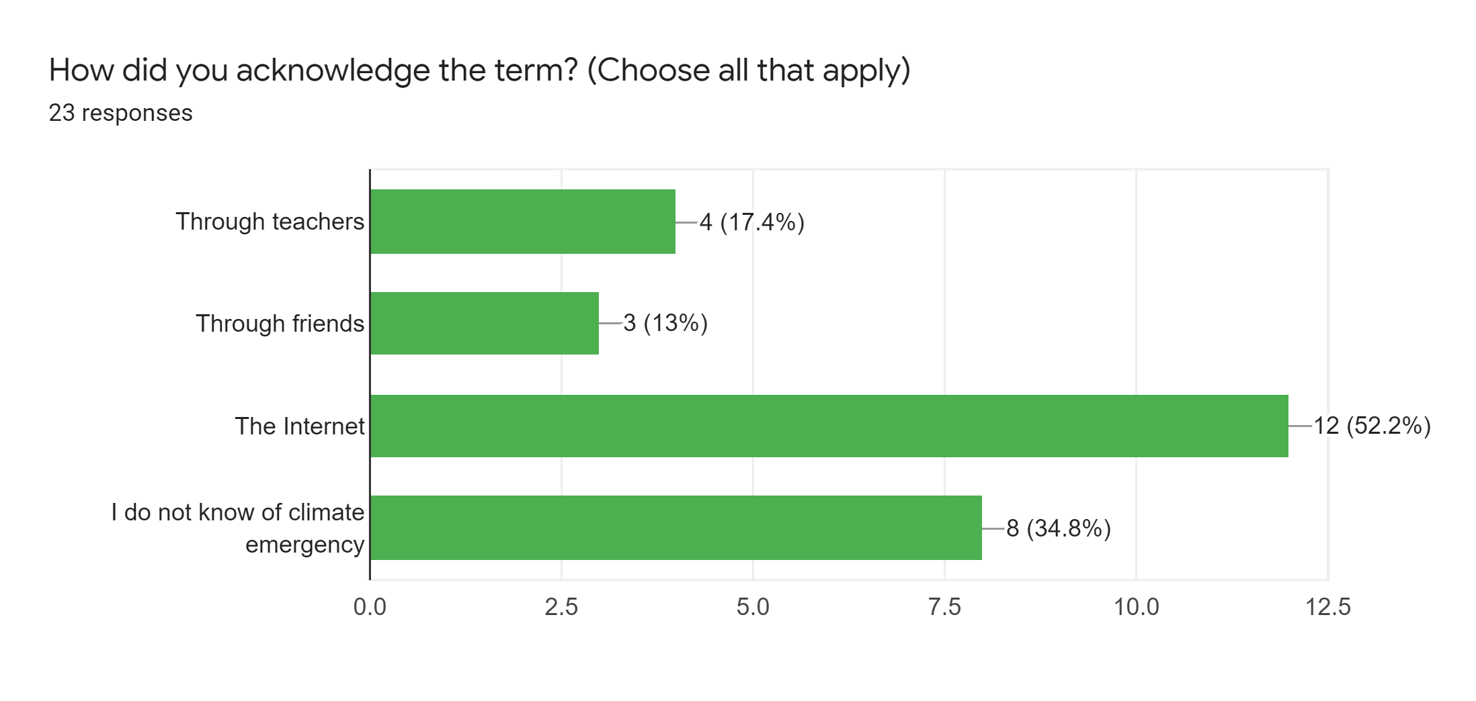
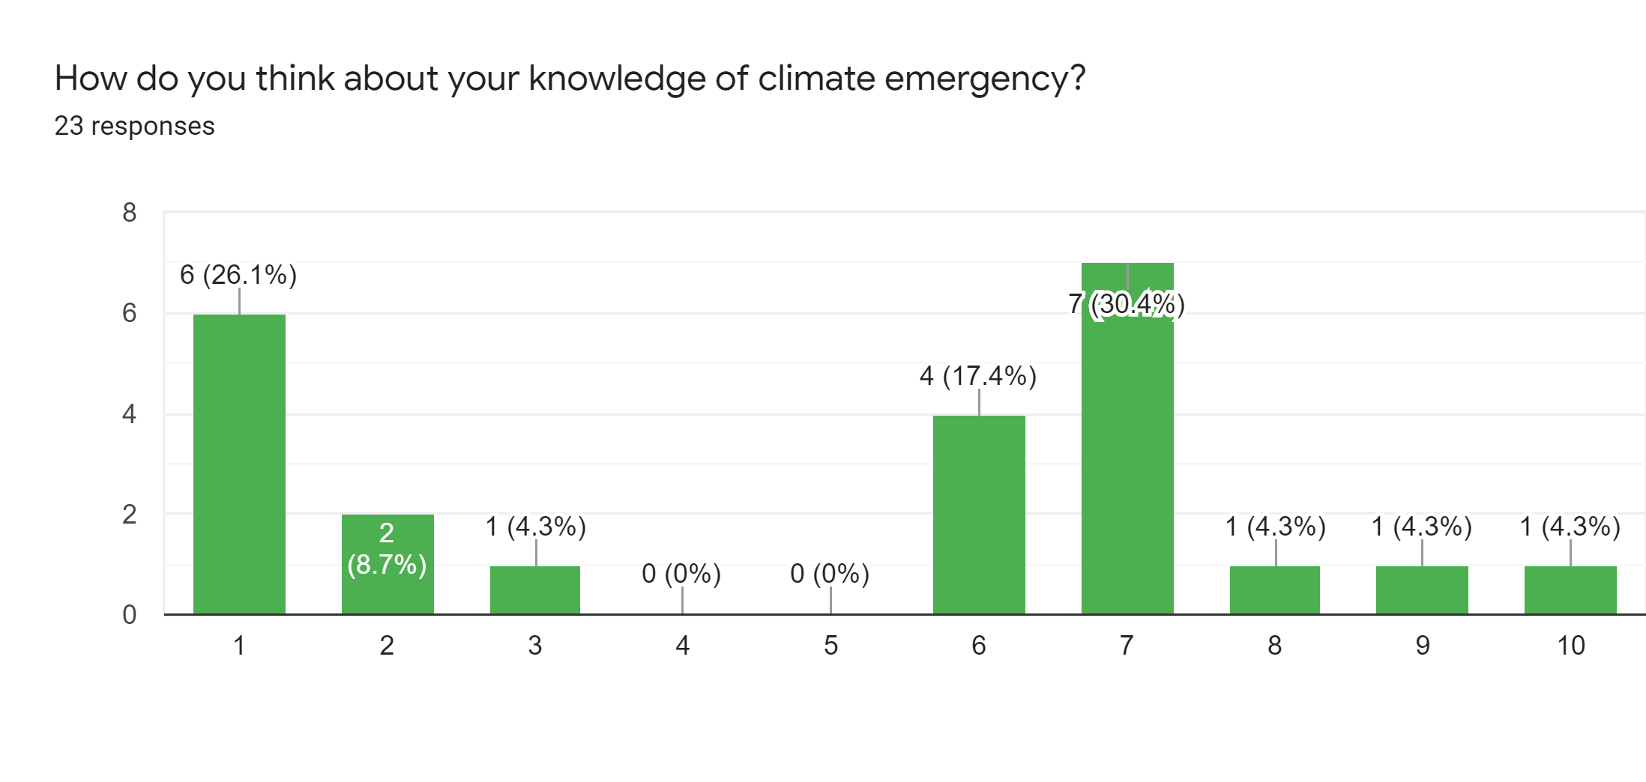
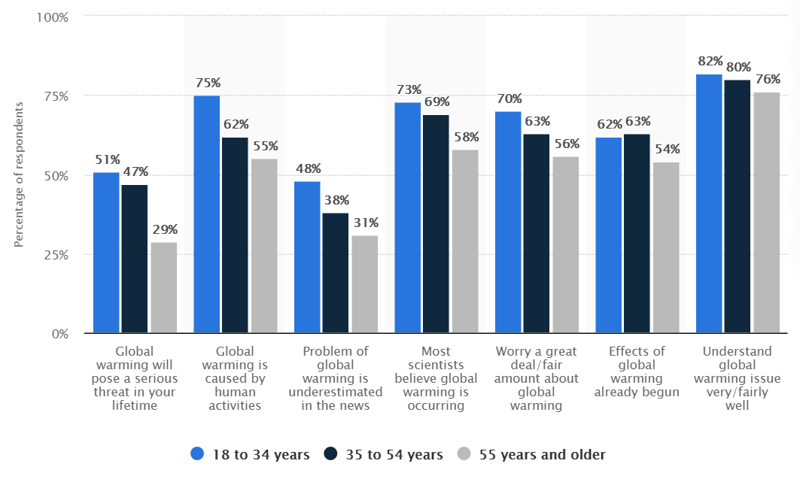

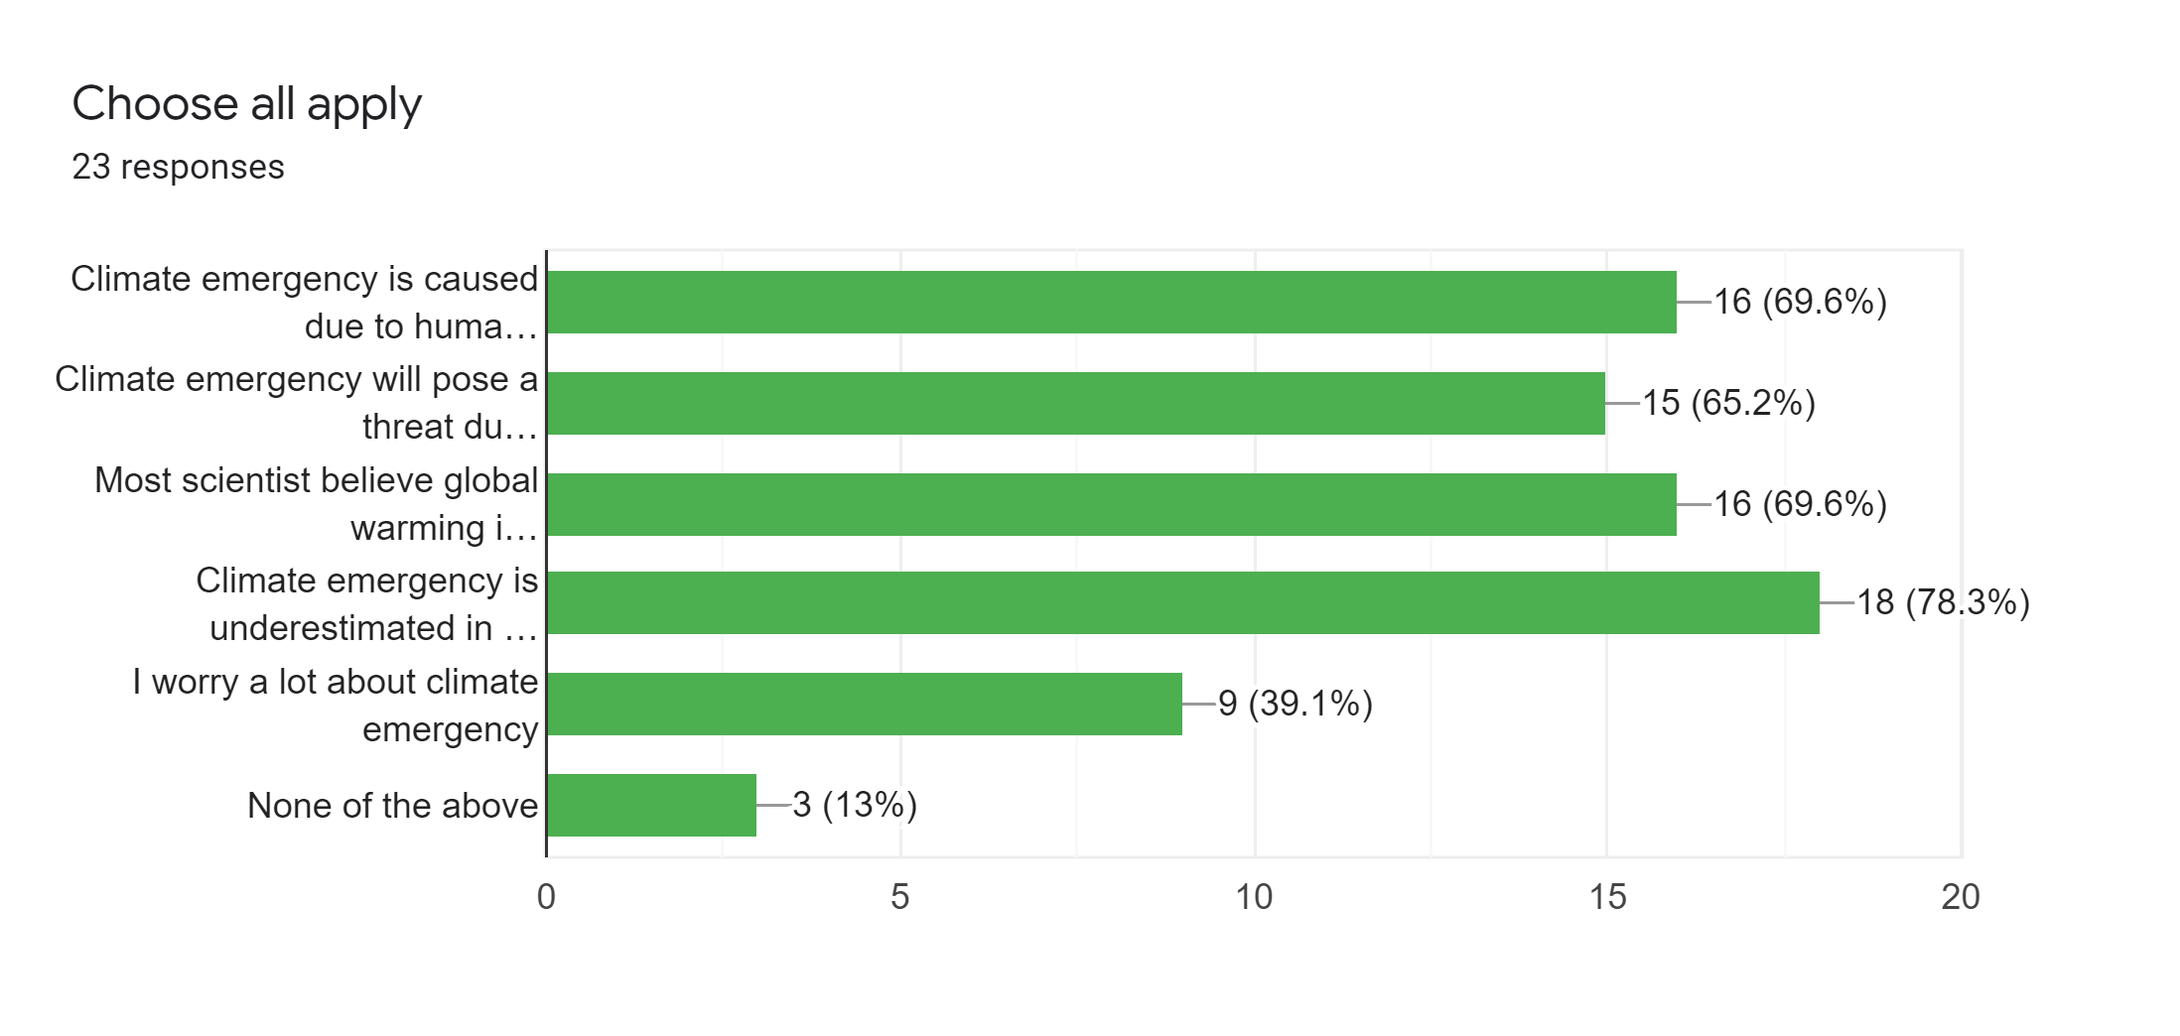
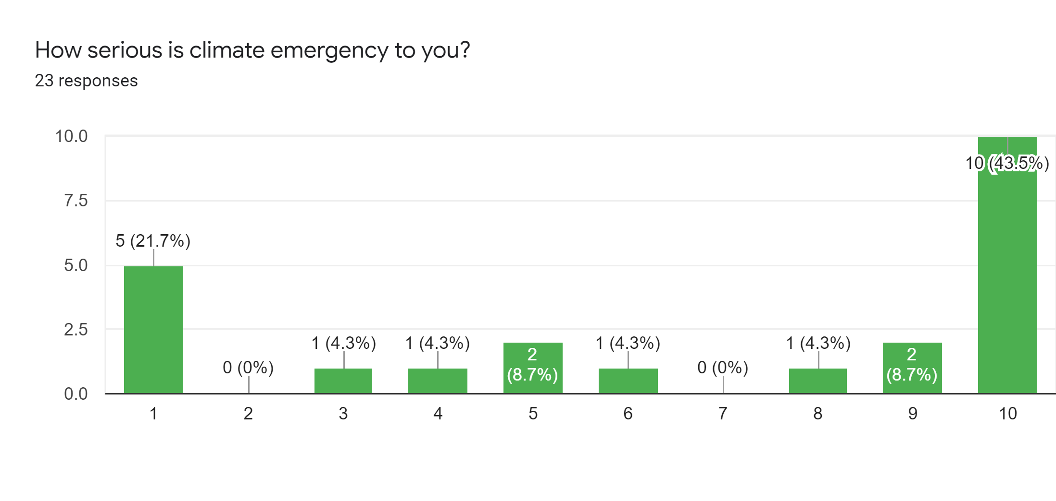


ALL DATA REFERENCES

Slide 18
A description for why I chose to conduct this research
←

Slide 19
Investigation
A continued display of the survey results. The survey results are interpreted.
8. Have they put anything into action?
<Source I>
Since source A did not contain survey results from the age group of 12 year olds, I have done a survey to compare the awareness between the first five questions asked. I considered the last two questions not useful for comparison as they did not have a big difference between each year group.
According to source B half of the responses say they have heard of the term “climate emergency”. However, it is important to note that the other half is unsure or has not heard of climate emergency. Therefore, the product must use quantitative methods.
Source C shows that the most common way of acknowledging climate emergency was through the Internet.
As shown in source D, 1 and 4 scored the highest. This means that most students did not know about climate emergency or even if they knew about it, they were not confident about it enough. As a result, the product should have both quantitative and qualitative methods: quantitative methods for the ones who replied 1 and qualitative methods for those who replied 4.
Source B and E suggests that even though people have heard of the term climate emergency, they do not look it up themselves. Therefore, it is crucial to have a product that draws the users attention to be actively engaged.
Source F shows that for about 54% think climate emergency is a serious issue. On the other hand, 46%, which is a fairly large amount, do not think so. This, followed by source B, supports the reason for a need in quantitative awareness.
Source H is very important as it provides a guideline on how I should approach my target users. As shown, games, school subjects, art, and physical activities are some of their common interests. Other interests include, cooking, reading and listening to music.
According to source G and I, it is safe to say that most 12 year-olds have interest in the environment and take action. Some of their eco-friendly actions include, turning the light off during the day and using sunlight through the window and using a search engine called “Ecosia” that helps plant trees. These sources mean that they have high potential for putting what they learned into practice. So, it is crucial to inform them about how they could contribute to slow down the rapid climate change.
These researches were very useful as I could have a better understanding of the context of where and how my product would be used.
I have conducted secondary research to draw out some possible actions one can take:
Travel responsibly
Eat sustainably
Shop differently
Save energy in homes
Support organizations dedicated to climate emergency
Minimize waste
Recycle
What it mean by traveling responsibly is for example, to travel short distances by walking or riding a bike instead of car. Also what it means by eating sustainably is to eat locally and seasonally while reducing meat consumption. Shopping differently refers to shopping products that are sustainable.
+About attractive and representative colour instead of appealing colour.

Slide 20
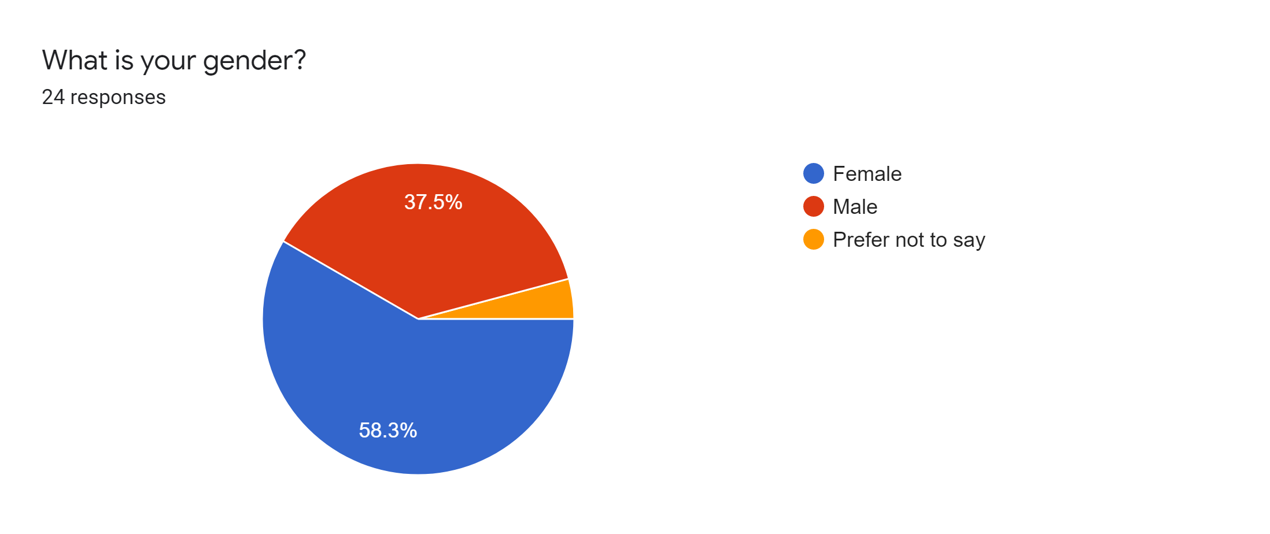

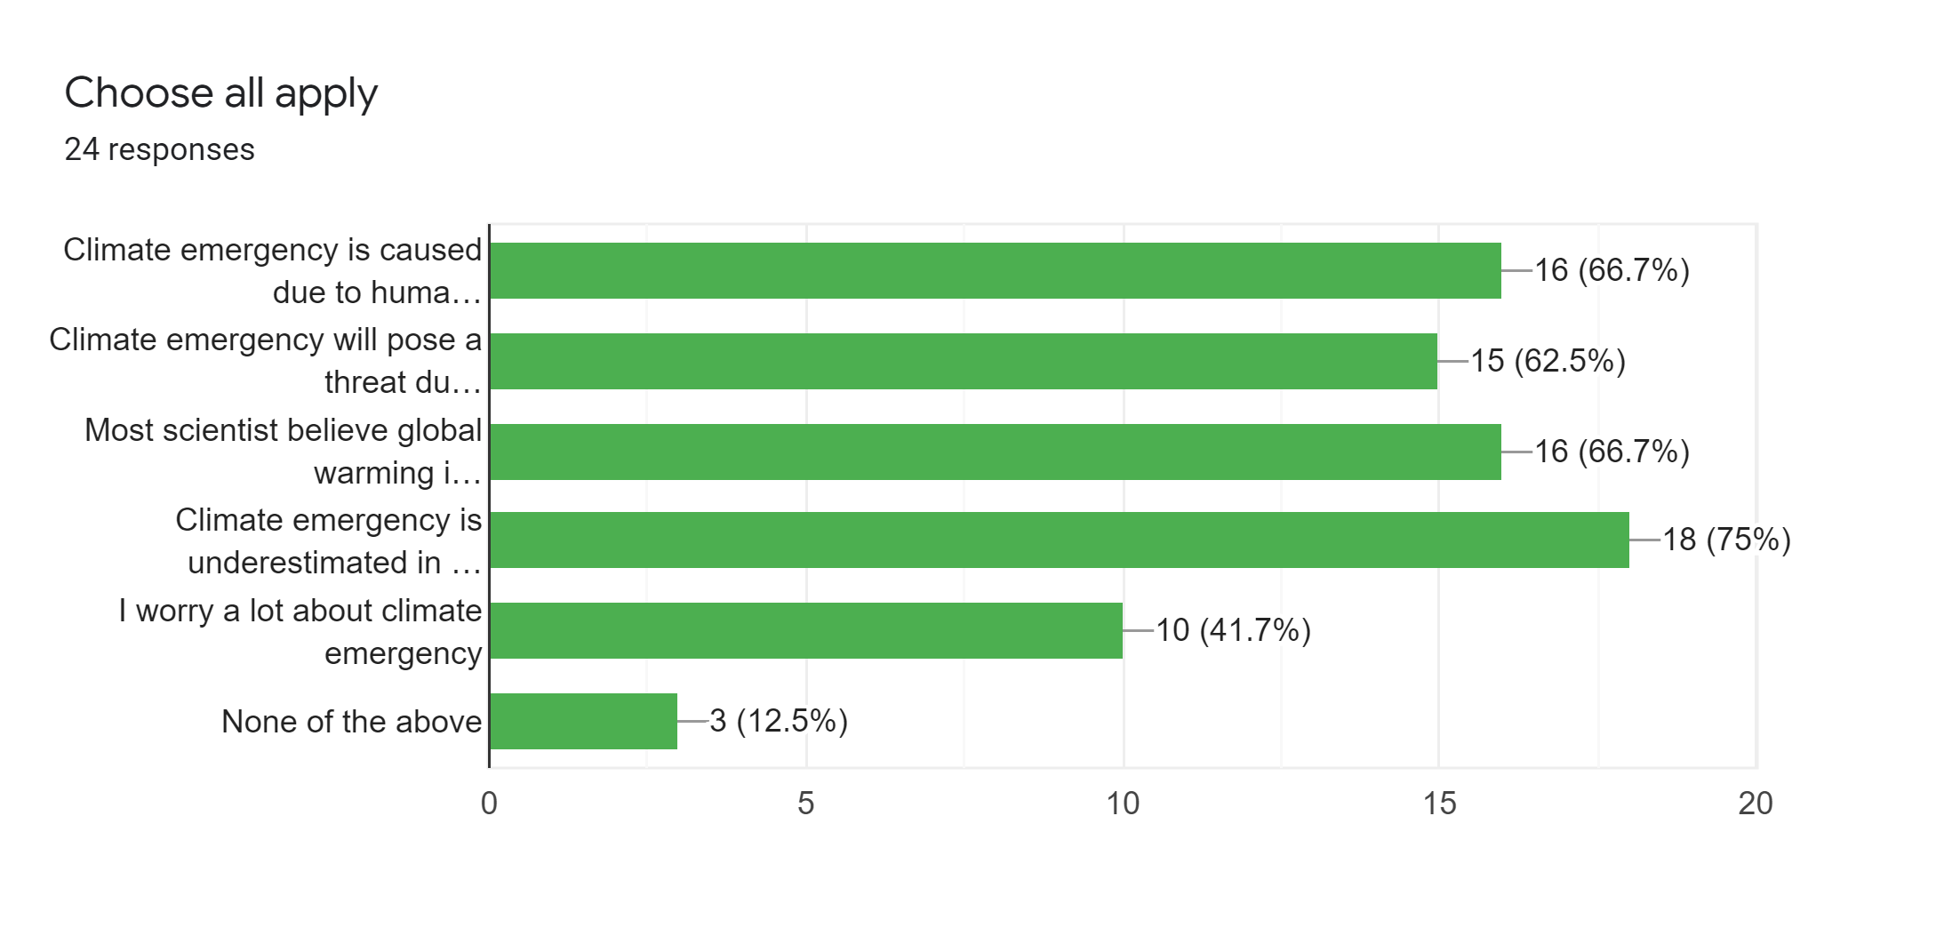
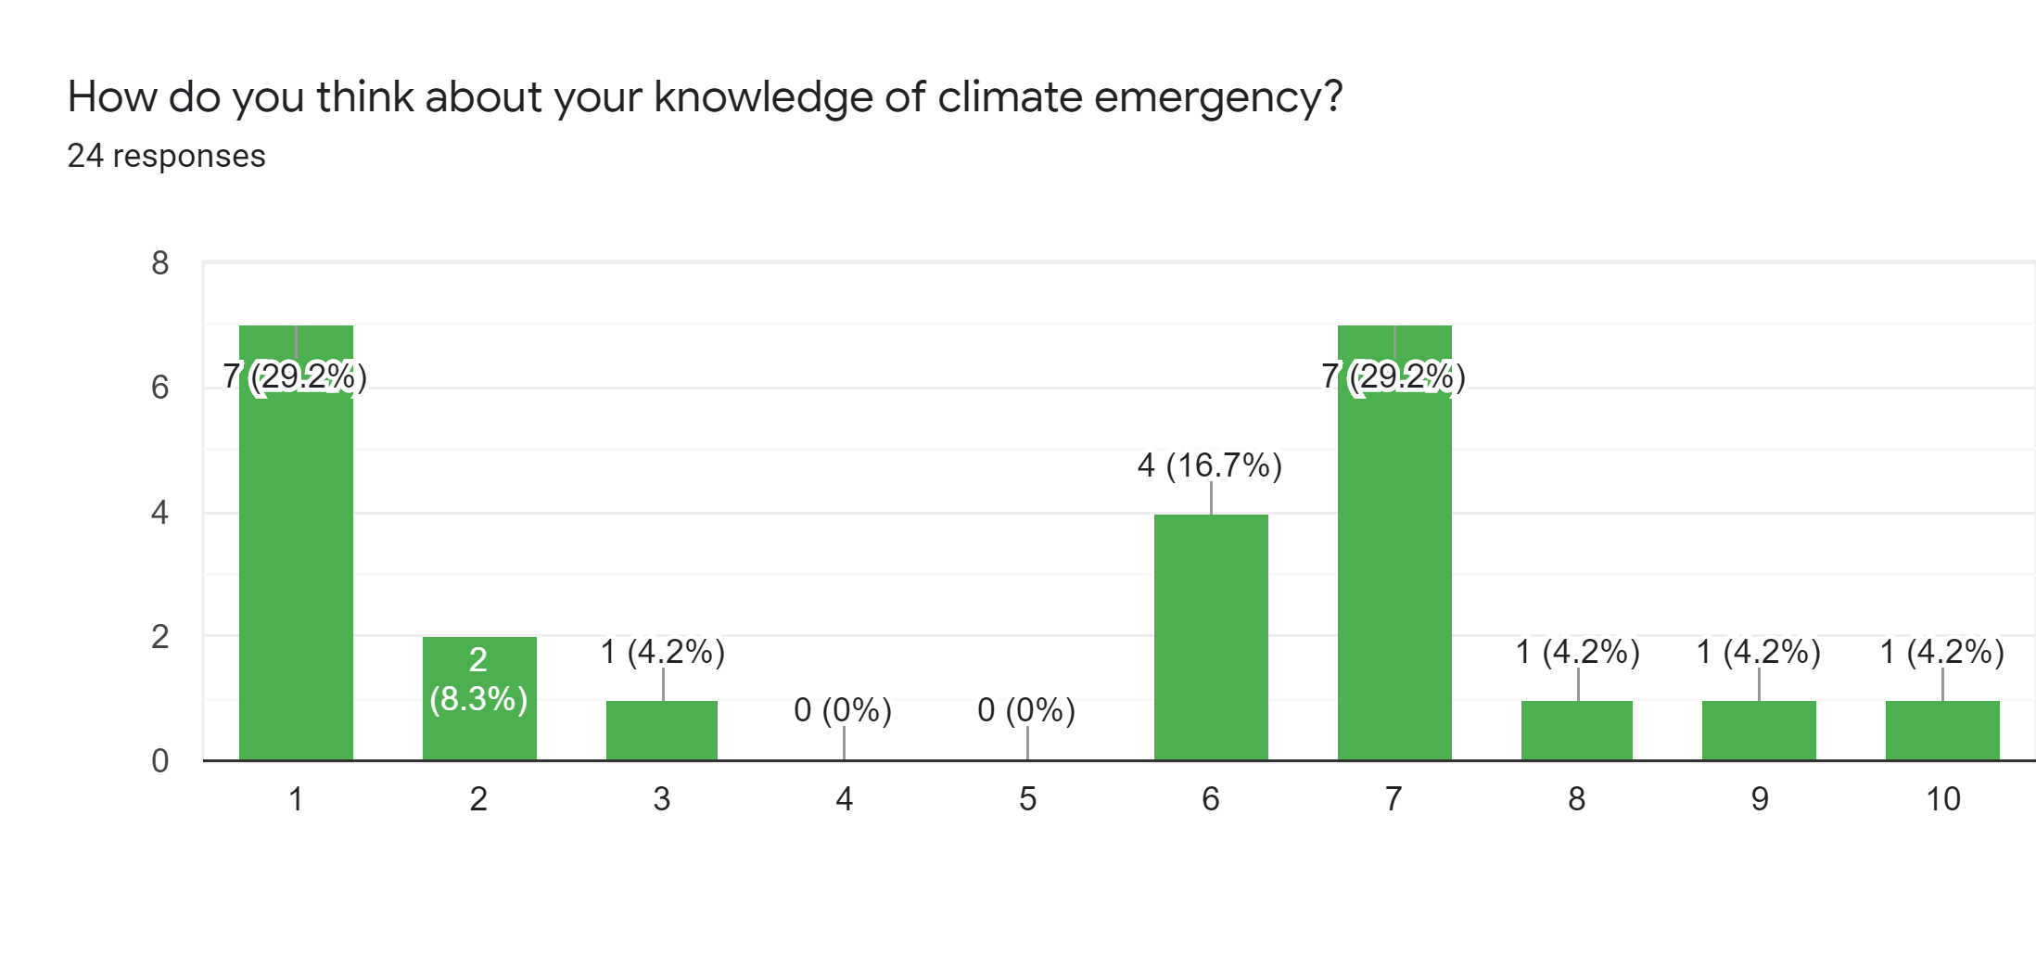
UPDATED DATA w/ 24 people.

Slide 21
NEW QUESTIONS TO ASK
Average allowance
Would you give up time to know more about climate emergency
What products do you use the most besides your smartphone?
How much is the school willing to pay for an education material.
What are the monetary limitations on my demographic?
This depends on where the product is being used. It has a possibility of being used in homes, schools or, malls.
Secondary user.
Schools and organisations that are willing to increase the awareness of climate emergency.
Brief description of design requirements.
A product that would successfully increase the awareness of the climate emergency.
Why commission my product?
The product would increase the
Cost Limitation
The student would not be buying the product. It would be schools or organisations. The cost limitations depends on their budget for teaching aids.
Other limitations
ENTERENTERENTERENTERENTERENTERENTER
Time scale/allocation
ENTERENTERENTERENTERENTERENTERENTER

Slide 22
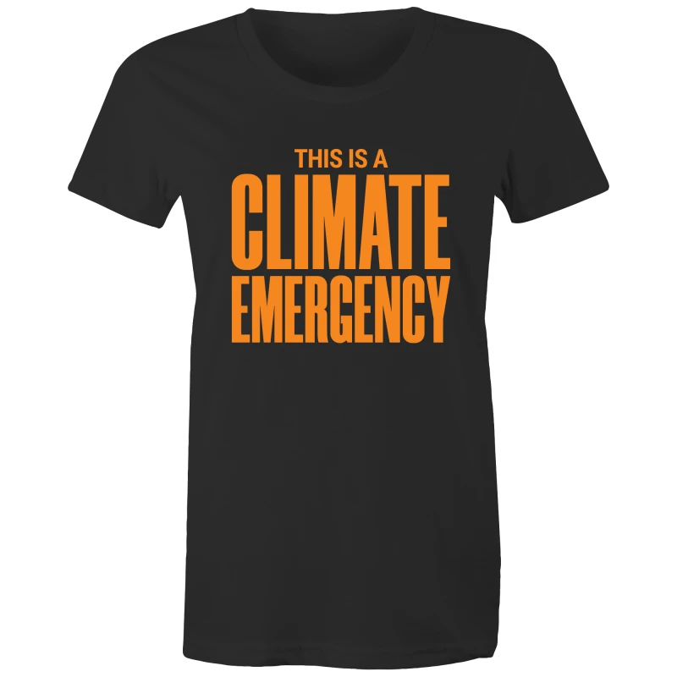
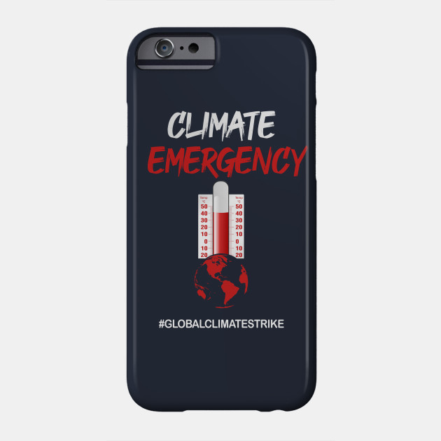
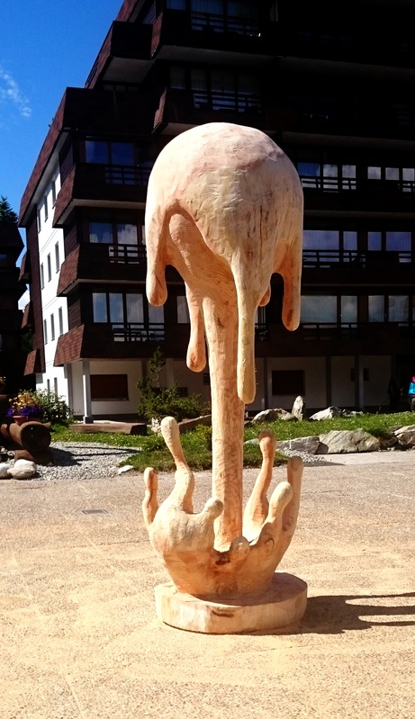
Investigation
Investigated existing products.
The colours represent advantages and disadvantages.
1. Climate emergency t-shirt
Aesthetics: The font styles and the colour contrast can be seen as aesthetic
Consumer: ENTERETERETETERETE
Cost: $33
Environment & Sustainability: Cotton is a renewable resource and doesn’t require chemicals. Also, it is durable. The product is manufactured in Australia but is sold worldwide. Therefore, the transportation process, which uses fossil fuels, increases the carbon footprint and hence the environment costs.
Size: Approximately 60cm in width and 80cm in height
Safety: No real concerns of danger
Function: It has two functions. One as the function of a clothing and the other to spread awareness to anyone who sees the clothing text.
Manufacture: The cotton textile is cut into the desired shape and the text is printed on it.
Materials: Plain weaved cotton (not timber)
2. Wooden Sculpture representing global warming.
Aesthetics: It is made as an artwork. The wood grains may seem appealing.
Consumer: ENTERETERETETERETE
Cost: $8,000 (too expensive)
Environment & Sustainability: The wood can be recycled or recovered as fuel. The wood could also be reused as this product has large areas where
Size: 210 cm x 60 cm x 60 cm (too big)
Safety: It may tip over.
Function: It alerts the audience about the urgency of the current climate emergency situation.
Manufacture: The timber is carved and sculpted.
Materials: Timber

Slide 23
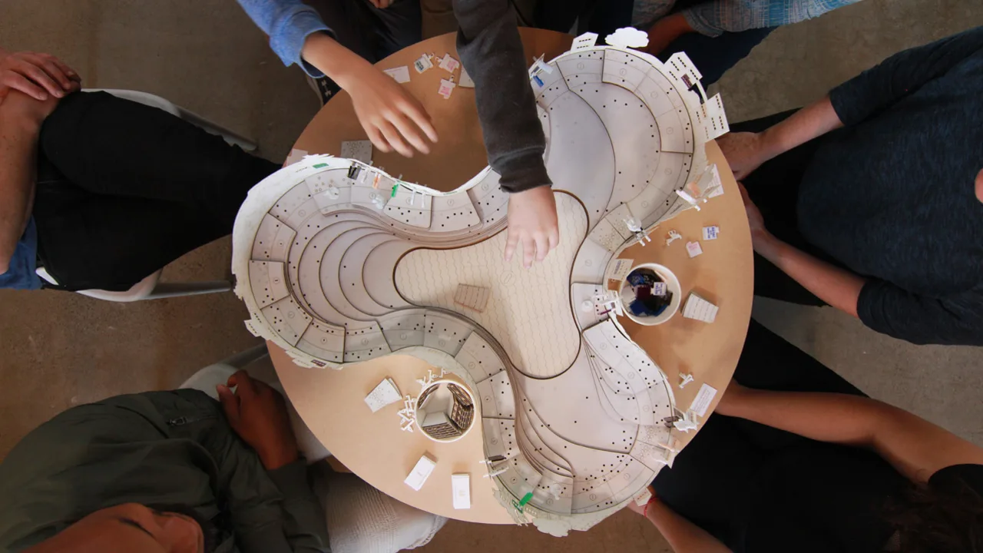
Investigation
Investigated existing products.
The colours represent advantages and disadvantages.
3 Climate emergency phone case
Aesthetics: No attributes that suggests the product to be aesthetic
Consumer: ENTERENTERENTERENTERENTERENTERENTER
Cost: $19
Environment & Sustainability: The metal rods could be reused and recycled. The plastic can be recycled. The use of plastic requires the use of petroleum which is a limited resource.
Size: About 10cm x 25cm x 30cm
Safety: Possibility of chocking from small parts. The pointing out metal rod can be dangerous.
Function: The user can experiment the global warming situation and understand the science behind it.
Manufacture: Polypropylene and polyethylene terephthalate would be moulded to form shape. Stock sized metal rods are used to minimise the manufacture process.
Materials: Plastic (polypropylene, polyethylene terephthalate), metal rods. Folding boxboard for the outer box. (Not timber)
4. Bartertown – a game of social resilience to climate change
Aesthetics: The curves and the simplistic design is aesthetic.
Consumer: ENTERENTERENTERENETERENTERENTERENTERENTER
Cost: Not more than $70 as it is mainly made with MDF which is a cheap material
Environment & Sustainability: MDF is made with waste wood and adhesive which makes it harder to recycle. Can be recovered as fuel. Some of the MDF could be reused as the product doesn’t contain that much decoration.
Size: About 10cm x 130cm x 130cm
Safety: It has curved edges. It is heavy and bulky for a boardgame. Also, it is not foldable. This increases the chance of being dropped or bumping into objects.
Function: An interactive boardgame based on climate change.
Manufacture: The computer aided design was sent to the CNC machine and it cut up the MDF into each parts for the boardgame. This method is fast and accurate compared to human manufacture.
Materials: Coated MDF

Slide 24
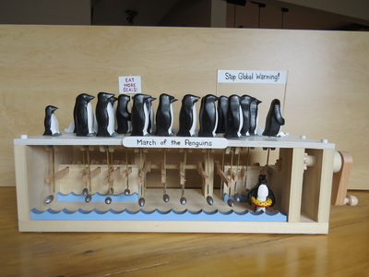
Investigation
Investigated possible ideas that I could use,
The colours represent advantages and disadvantages.
1. Climate emergency t-shirt
Aesthetics: The font styles and the colour contrast can be seen as aesthetic
Consumer: ENTERETERETETERETE
Cost: $20
Environment & Sustainability: Cotton is a renewable resource and doesn’t require chemicals. Also, it is durable. The product is manufactured in Australia but is sold worldwide. Therefore, the transportation process, which uses fossil fuels, increases the carbon footprint and hence the environment costs.
Size: Approximately 60cm in width and 80cm in height
Safety: No real concerns of danger
Function: It has two functions. One as the function of a clothing and the other to spread awareness to anyone who sees the clothing text.
Manufacture: Cotton is loomed and weaved. Then it is cut into the desired shape. Lastly, the text is printed on the shirt.
Materials: Cotton (not timber)
2. Automata
Aesthetics: It is made as an artwork. The wood grains may seem appealing.
Consumer: ENTERETERETETERETE
Cost: ranges from $15(build kits) to $950(high-quality automata)
Environment & Sustainability: The wood can be recycled or recovered as fuel. The wood could also be reused as this product has large areas where
Size: 210 cm x 60 cm x 60 cm (too big)
Safety: It may tip over.
Function: It alerts the audience about the urgency of the current climate emergency situation.
Manufacture: The timber is carved and sculpted.
Materials: Timber

Slide 25
Investigation
Investigated possible ideas that I could use,
The colours represent advantages and disadvantages.
Investigating existing products – Ideas I could use:
3. Water bottles
Aesthetics: The font styles and the colour contrast can be seen as aesthetic
Consumer: ENTERETERETETERETE
Cost: $33
Environment & Sustainability: Cotton is a renewable resource and doesn’t require chemicals. Also, it is durable. The product is manufactured in Australia but is sold worldwide. Therefore, the transportation process, which uses fossil fuels, increases the carbon footprint and hence the environment costs.
Size: Approximately 60cm in width and 80cm in height
Safety: No real concerns of danger
Function: It has two functions. One as the function of a clothing and the other to spread awareness to anyone who sees the clothing text.
Manufacture: Cotton is loomed and weaved. Then it is cut into the desired shape. Lastly, the text is printed on the shirt.
Materials: Cotton (not timber)
2. Wooden Sculpture representing global warming.
Aesthetics: It is made as an artwork. The wood grains may seem appealing.
Consumer: ENTERETERETETERETE
Cost: $8,000 (too expensive)
Environment & Sustainability: The wood can be recycled or recovered as fuel. The wood could also be reused as this product has large areas where
Size: 210 cm x 60 cm x 60 cm (too big)
Safety: It may tip over.
Function: It alerts the audience about the urgency of the current climate emergency situation.
Manufacture: The timber is carved and sculpted.
Materials: Timber

Slide 26
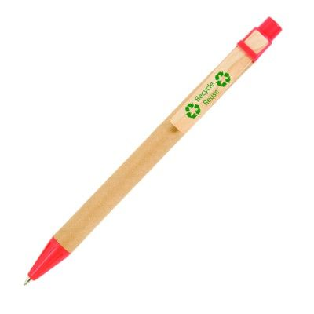
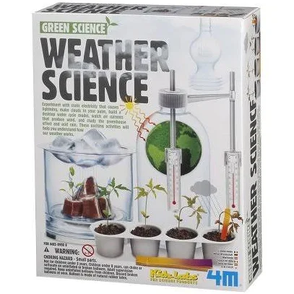
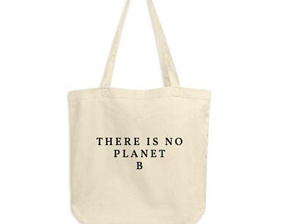
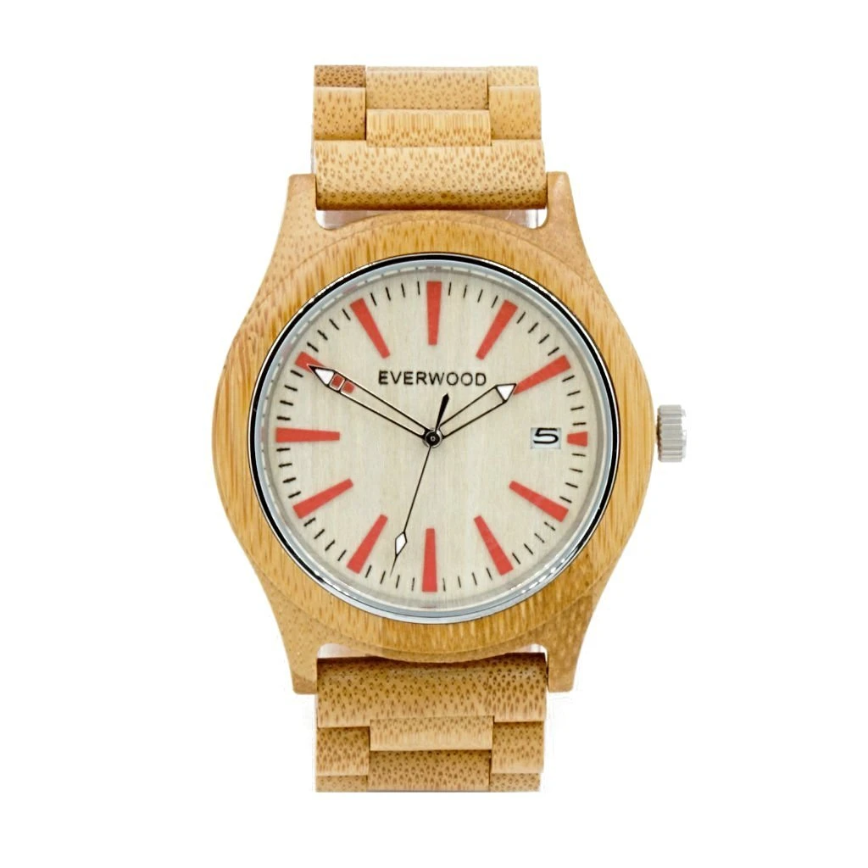
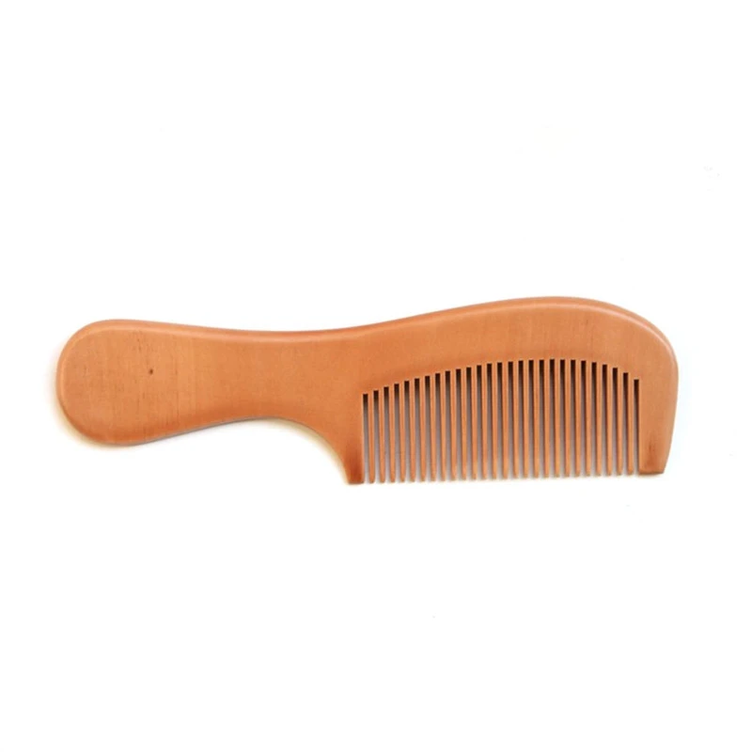
Research
The colours represent advantages and disadvantages.
Existing Products:
3. Bamboo with
Aesthetics:
Consumer:
Environment & Sustainability: Bamboo is environmentally friendly as it grows fast and can be easily replaced.
Size:
Safety:
Function:
Manufacture: the bamboo is drilled to have a hole in the middle. Then it is lathed. Finally the pen parts are attached to form a pen.
Materials: Bamboo

Slide 27
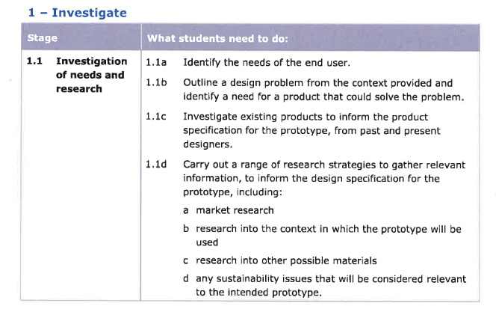
Spec
Needs of users
Research users
Outline design (FIND A NEED)
Investigate existing products
Other researches for design specification

